Slide 1

HANDYMAN
FRANCHISE
Joining fee £1,995
we LOVE small to medium sized jobs
www.mrjobi.uk

Slide 2
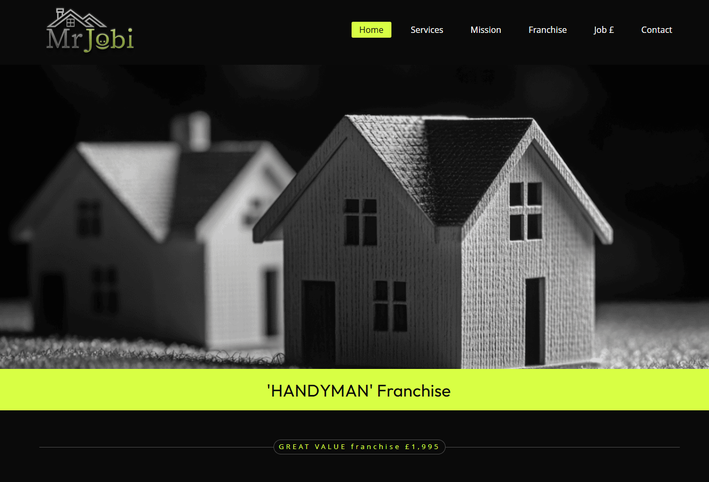

Slide 3

A few Services You Can Offer
You can offer as many services as you wish & expand at any time
We will fully customize to your services
Handyman
Tiling
Power Washing
Our handyman service covers a wide range of services that clients need undertaken ranging from fitting simple wall shelving through to tackling long lists of required tasks!
Some Mr Jobi local franchise owners offer tiling services to their clients. Regardless of it being just a few rows of sink splashback tiles to larger sized projects.
Power washing or alternatively named 'Jet Cleaning' is guaranteed to bring AMAZING cleaning results. Mr Jobi local operators can make grubby looking items sparkle like new.

Slide 4
+ A few More Services You May Want to Add
You get to choose the services to offer your clients
Painting & staining
Small plumbing jobs
Flat packs
Our Mr Jobi local operators can offer a comprehensive service with most offering painting, glossing and staining services.
When your clients are in true need of 'HELP!’, as a Mr Jobi handyman franchisee, you could be the perfect 1st call by isolating the water feed.
This is most peoples biggest dislike when buying all manner of new items. If you join us as a franchisee, your clients will no doubt keep you BUSY.

Slide 5
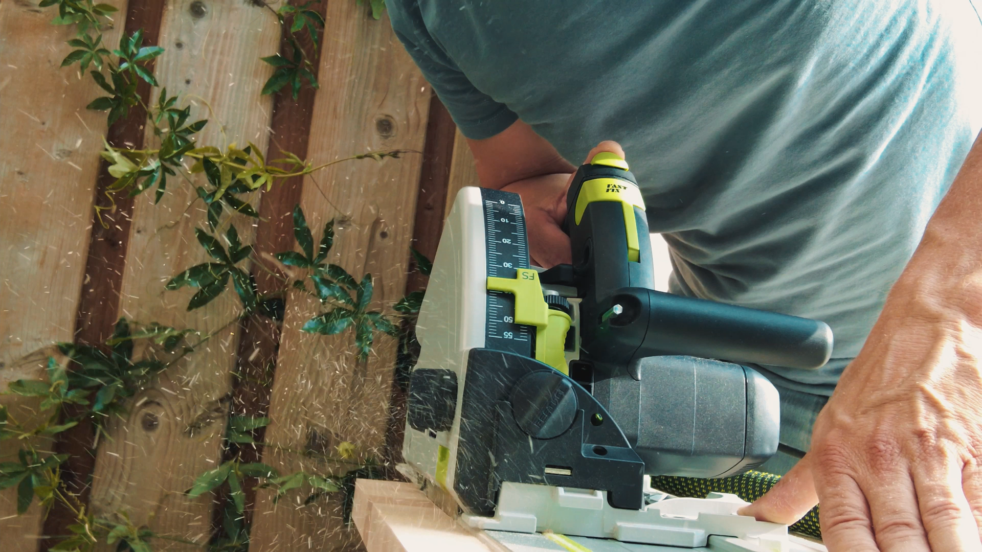

www.mrjobi.uk

Slide 6
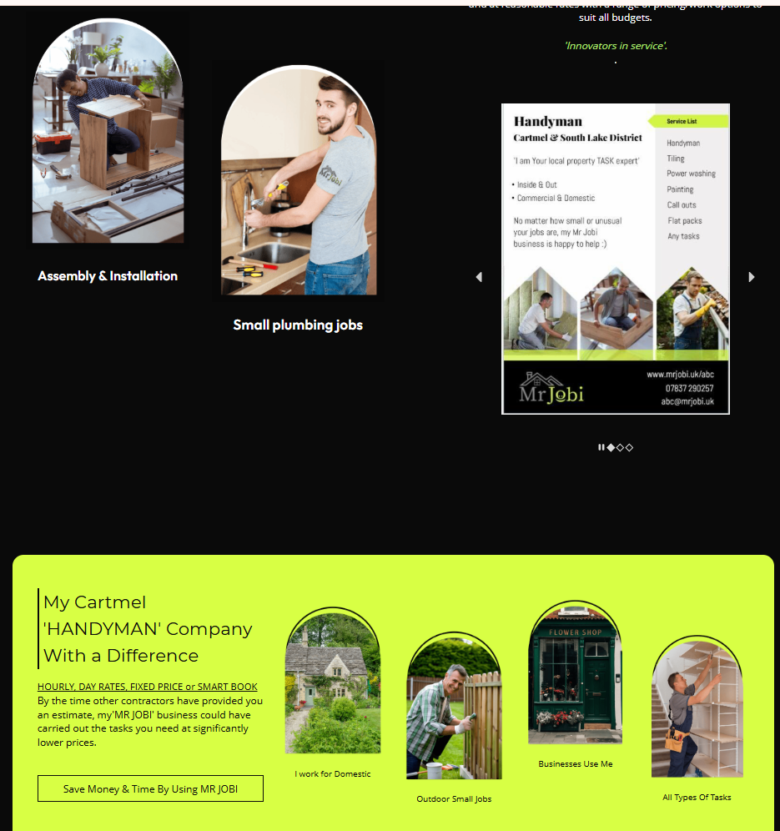
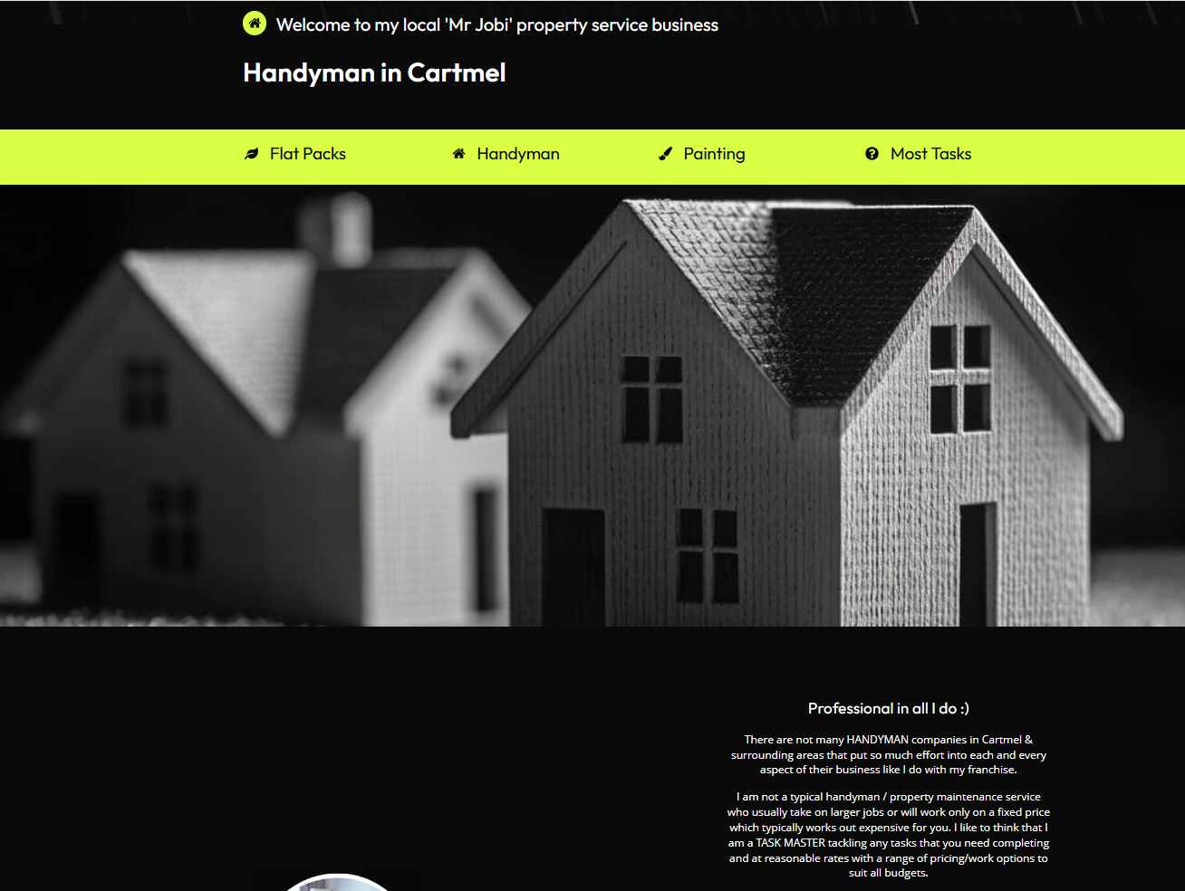
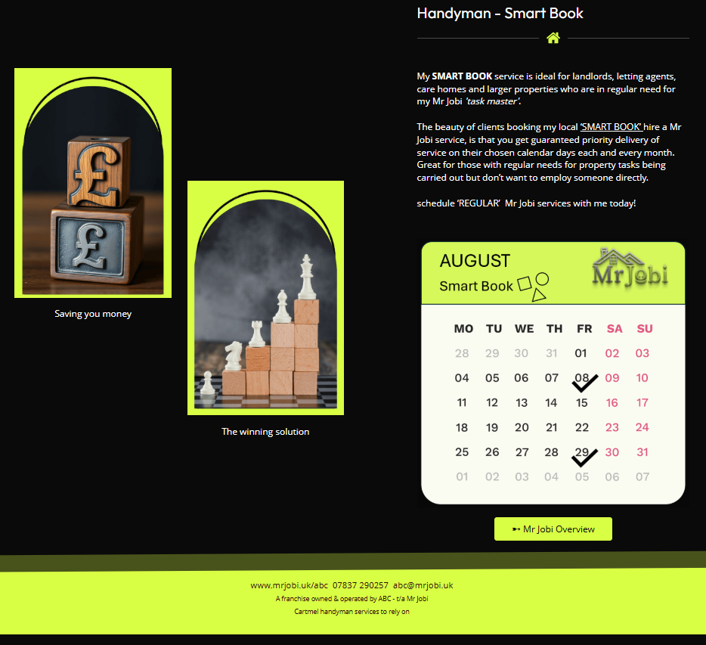
You receive a VERY attractive webpage fully customized for you in your chosen work area/s
Example page 1 Google, search ‘handyman in Cartmel’ www.mrjobi.uk/abc

Slide 7

You will look so professional
Mr Jobi local franchisees receive a combination of professional e-business cards, e-brochures, e-letter header paper. 1000 actual printed colour flyers, 2 x quality embroidered polos or t-shirts are included. Additional can be bought at any time in the future. www.mrjobi.uk/shop

Slide 8
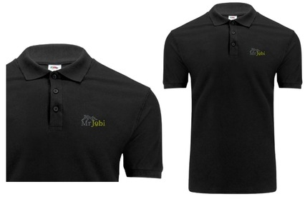
Great value franchise £1,995

Slide 9

Your Own LOCAL FOCUSED Promo video + Hosting Mr Jobi provides

Slide 10



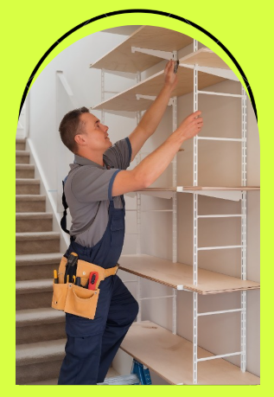
Join Our Growing National 'Property CARE' Company With a Difference
YOU CAN SET HOURLY, DAY RATES, FIXED PRICES OR SMART BOOK
.
Make GREAT money
You choose the jobs to take on
Mr Jobi a Winning Company
Businesses LOVE
Mr Jobi

Slide 11

We invite you to join the 'Mr Jobi' network

Slide 12
Meet Mr Jobi
Mr Jobi even LOVES the more unusual tasks and thrives on lists.
A REFRESHING change to what’s out there!

Slide 13
Franchise Financials
£1,995
JOINING FEE: customised to your local MR JOBI business
£99
ACCOUNT MAINTENANCE: just £99 p/m which covers all your franchise operating system as described on www.mrjobi.uk/franchise
£0
Pay zero 0% royalty and commission ever
£0
Hidden costs

Slide 14

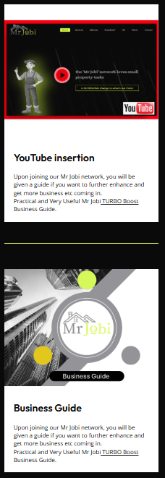
You really do receive so much when you join us at Mr Jobi.
www.mrjobi.uk

Slide 15
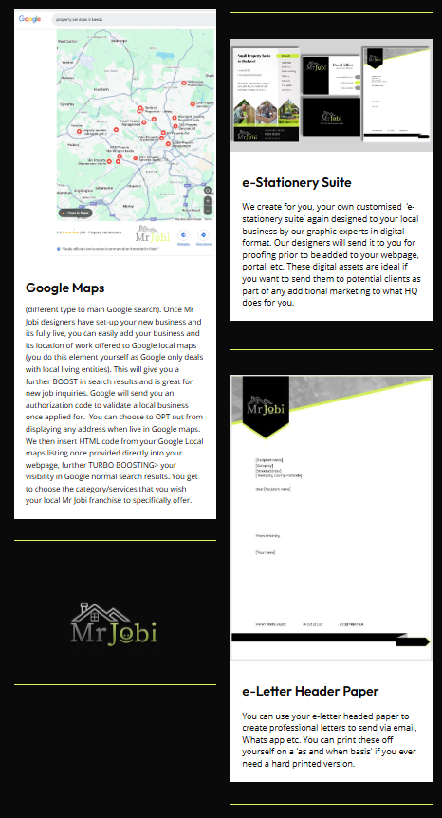
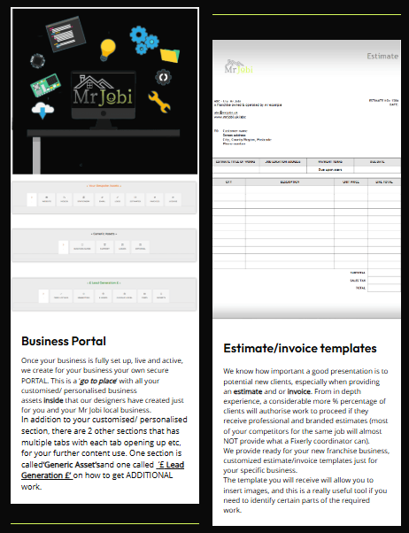
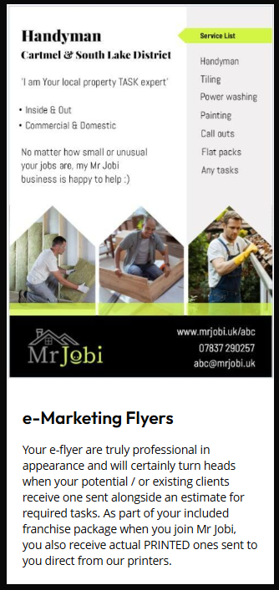
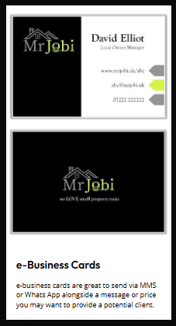
+ Plus a huge list also included
www.mrjobi.uk/franchise

Slide 16





Questions?
Dominic
(franchise network manager)
info@mrjobi.uk
07837 290257
www.mrjobi.uk/franchise

